Slide 1
Adversarial Attacks on Neural Networks in the Image Classification Domain
Gurparteek Singh

Slide 2
Overview of the Presentation
Section 1 – Topic Overview
Section 2
Background
Limitations
Adversarial Examples
Defensive Distillation
Motivation
Simple Black Box Adversarial Attacks

Slide 3
Section 1
Topic Overview

Slide 4
Background – Neural Networks
A Neural Network (NN) is set of algorithms which are designed to:
Identify patterns
learn new things
mimic how the human brain makes decisions.
solve complex problems, data validation, risk management and many other applications in the world.
In the Image Classification Domain, NN can be trained to recognise images with accuracy of almost human i.e. give an image to identify it as a stop sign or a speed limit sign.
Other Domains:
Malware Classification: Identify a file as malware or benign.
Speech Recognition: Generate audio that sounds like speech to machine learning, but not to humans.
Self- driving cars, drones, robots, malware classification, speech recognition and many more.

Slide 5
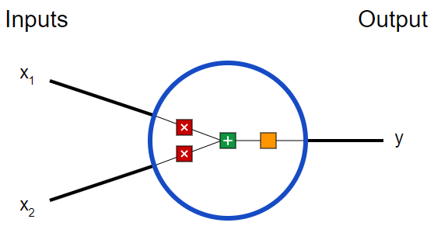
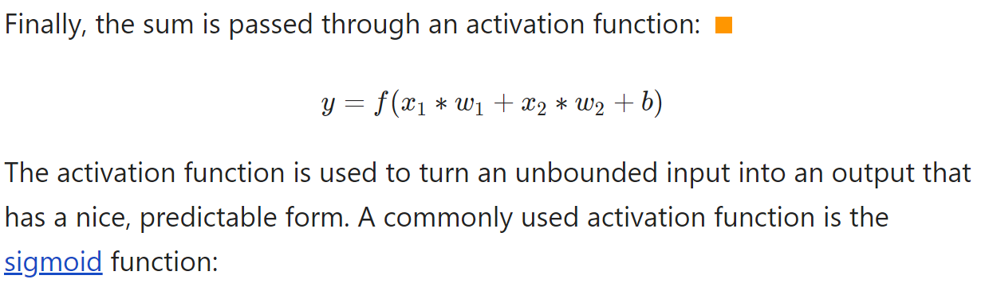
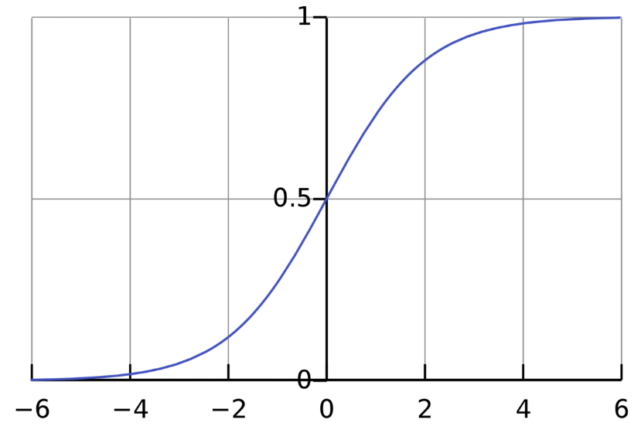
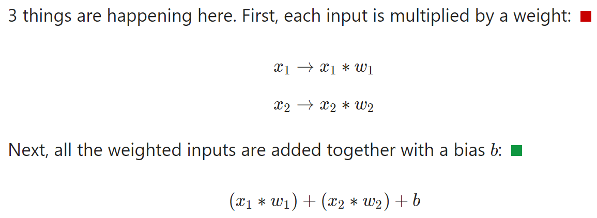
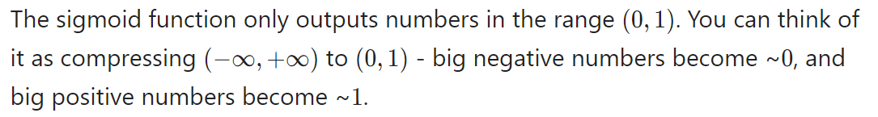
Background – Basic Neural Network Example
Source: https://victorzhou.com/blog/intro-to-neural-networks/
Notes:
A neuron takes inputs, does some math with them, and produces one output.

Slide 6
Limitations
Neural Networks are vulnerable to adversarial attacks. This makes it difficult to apply neural networks in security-critical areas.
Adversarial examples are close to the original. Some examples include:
if we use neural networks in self-driving cars, adversarial examples could allow an attacker to cause the car to take unwanted actions.
Transform an image by a small amount and thereby change how the image is classified.
Often, the total amount of change required can be so small as to be undetectable.

Slide 7
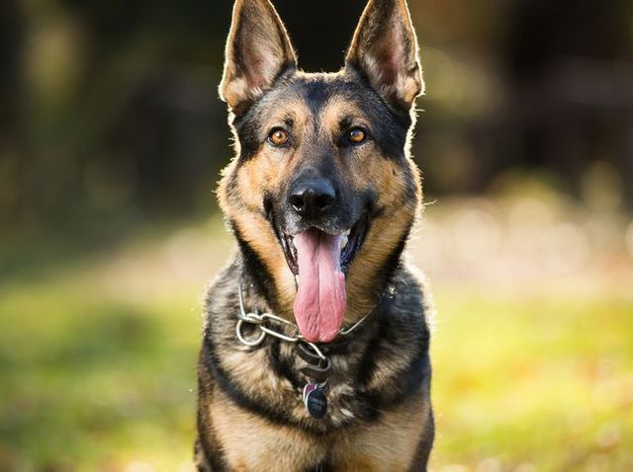
Adversarial Examples
For a classification neural network F(x)
Given input X classified as label L
Easy to find an X’ close to X
So that F(X’) = L
i.e. the network will identify the image on right as a cat.

Slide 8
Source: https://towardsdatascience.com/breaking-neural-networks-with-adversarial-attacks-f4290a9a45aa
Notes:
We start with an image of a panda, which our neural network correctly recognizes as a “panda” with 57.7% confidence. Add a little bit of carefully constructed noise and the same neural network now thinks this is an image of a gibbon with 99.3% confidence!

Slide 9
Source: https://towardsdatascience.com/breaking-neural-networks-with-adversarial-attacks-f4290a9a45aa
Notes:
The images shows real graffiti on a Stop sign, something that most humans would not think is suspicious. The right image shows a physical perturbation applied to a Stop sign. The systems classify the sign on the right as a Speed Limit: 45 mph sign! Source: Robust Physical-World Attacks on Deep Learning Visual Classification.

Slide 10
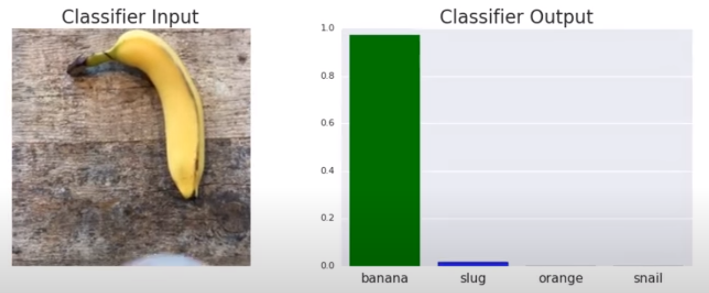
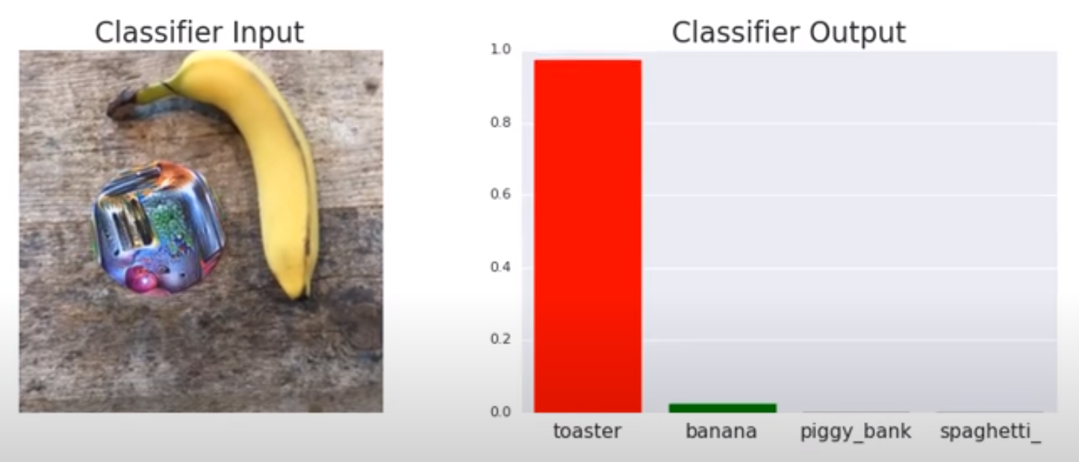
Source: https://towardsdatascience.com/breaking-neural-networks-with-adversarial-attacks-f4290a9a45aa

Slide 11
Defensive Distillation
Initial research proved to be very promising, defensive distillation defeated existing attack algorithms and reduced their success probability from 95% to 0.5%
However, Defensive distillation does not significantly increase the robustness of neural networks as stronger attack algorithms are introduced.
Defensive distillation can be applied to any feed-forward neural network and only requires a single re-training step and is currently one of the only defenses that gives only some security against adversarial examples.
More details about this later.
feed-forward neural: information only moves in one direction

Slide 12
Motivation
It is vital to find stronger defenses against adversarial attacks it can have catastrophic impacts.
To consider:
Defensive Distillation does not offer much defense against stronger attacks
Very easy for adversarial examples to obtain high confidence
Very little noise was added to fool the classifiers
An adversarial example trained for one network seems to confuse another one as well. This is known as transferability.

Slide 13
Section 2
Simple Black-Box Adversarial Attacks

Slide 14
White Box vs Black Box Attack
White Box
Black Box
Classifier Model
Classifier
Model
Label
Label
Information required about the Image and the output label (this could also be partial information)
Information required complete knowledge of the Classifier Model
Notes:
For White Box:

Slide 15
White Box vs Black Box Attack
Attacking a classifier turns into a search problem within a small volume around a target image.
White Box
Black Box
Gradient Decent is effectively used to guide the search problem.
Assumptions are unrealistic for real world application.
Black Box is applicable in many scenarios.
Queries to the model incurs time and money.
Efficiency can be measured with the number of queries
Most efficient attack requires tens or hundreds of queries
Notes:
This black-box threat model is much more challenging for the adversary since gradient information may not be used to guide the
finding of the adversarial direction S , and each query to the model incurs a time and monetary cost.
Thus, the adversary is tasked with an additional goal of minimizing the number of black-box queries to h while succeeding in constructing an imperceptible adversarial perturbation

Slide 16


Machine Learning Services
Notes:
Services such as Clarifai or Google Cloud Vision only allow API calls to access the model’s predictions and they fall under the black-box category.
No access to internal information however, their predictions return continuous-valued confidence scores

Slide 17
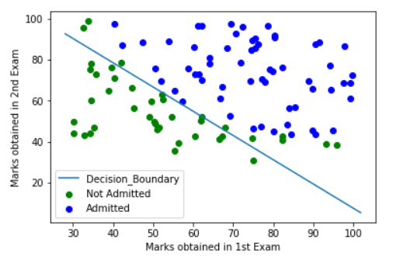
Decision Boundary
Source: https://towardsdatascience.com/decision-boundary-visualization-a-z-6a63ae9cca7d

Slide 18
Highly Effective Black Box Attack Explained
If the distance to a decision boundary is small, the direction we traverse does not matter
Repeatedly pick a random direction among a pre-specified set of orthogonal search directions
Use the confidence scores to check if it is pointing towards or away from the decision boundary
Perturb the image by adding or subtracting the vector from the image.
Each update moves the image further away from the original image and towards the decision boundary
Due to its simplicity, it can be implemented in PyTorch in under 20 lines of code and refer to as Simple Black-box Attack (SimBA).
Source: Simple Black-box Adversarial Attacks
Proceedings of the 36th International Conference on Machine Learning, Long Beach, California, PMLR 97, 2019

Slide 19
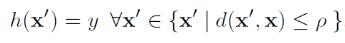

Background - SimBA
The task of image classification is defined as success fully predicting what a human sees in an image. We can formalise such robustness property as:
h is the model
Input-label pair (x,y)
h is said to be p-robust with respect to perceptibility metric d(.,.)
d is the distance metric L0, L1, L
d(x,x’) = ||x – x’||
Source: Simple Black-box Adversarial Attacks
Proceedings of the 36th International Conference on Machine Learning, Long Beach, California, PMLR 97, 2019
Notes:
Distance Metrics: Distances to measure the degree of visual dissimilarity between the clean input x and the perturbed input x’.
Geometrically, the region of imperceptible changes is therefore defined to be a small hypersphere with radius p, centred around the input image x.

Slide 20
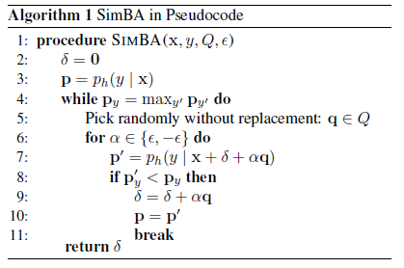


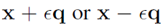
Simple Black-box Attack (SimBA)
x: input image
y: label
: adversarial direction
ph(y | x): output probability
q: random direction
:Step size > 0
L likely to decrease the probability.
Q: a set of orthonormal candidate vectors
Source: Simple Black-box Adversarial Attacks
Proceedings of the 36th International Conference on Machine Learning, Long Beach, California, PMLR 97, 2019
Notes:
Our goal is to find the small perturbation delta such that the prediction h(x+delta) != y
To minimize the number of queries to model h(.) we always first try adding q. If this decreases the probability ph(y j x) we take the step, otherwise we try subtracting q.
For simplicity we pick q E Q uniformly at random.
LINE 5: For this reason we pick q without replacement and restrict all vectors in Q to be orthonormal.
To guarantee maximum query efficiency, we ensure that no two directions cancel each other out and diminish progress, or amplify each other and increase the norm of disproportionately.
LINE 6:
Each iteration a basis vector is either added, subtracted, or discarded
(if neither direction yields a reduction of the output probability.)
the sign of the search direction chosen at step t

Slide 21
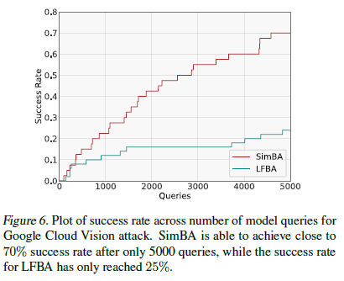
Notes:
LFBA = Low Frequency Boundary Attack
The Google API charges $1.50 for 1000 image queries. So $150 per image.

Slide 22
